Slide 1


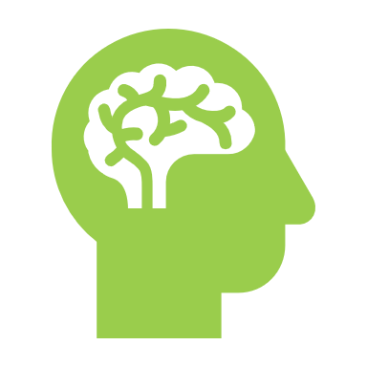
AI-Powered VR Therapy for Mental Health
SUPERVISED BY :
Ms. Nabia Khalid
PRESENTORS :
(AI-S25-07)
Babar ali
01-136221-051
Muhammad Taqui
01-136221-021

Slide 2
Introduction
This project aims to develop an AI-driven virtual assistant within a VR environment to support mental health therapy.
The system will use Natural Language Processing (NLP) to interact with users, analyze emotions, and offer personalized therapeutic experiences.
If signs of stress or depression are detected, the assistant will trigger immersive VR simulations (e.g., calming nature scenes) to improve mood.

Slide 3
Objectives
Develop an AI-Powered Virtual Assistant
01
Integrate NLP for Emotion Detection
02
Create Personalized VR Therapy Environments
03
Enhance User Engagement with Real-Time Feedback
04

Slide 4
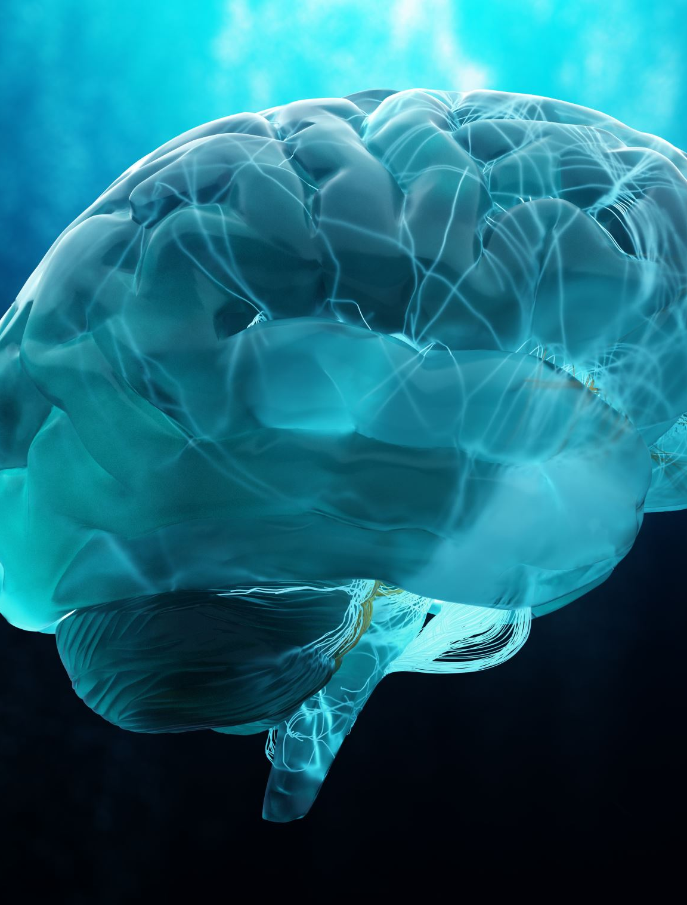
Problem description
Rising Mental Health Issues
Lack of Personalized Therapy
Limited Use of AI & VR in Therapy
Need for Accessible & Engaging Solutions
Many individuals avoid therapy due to stigma or discomfort in face-to-face sessions, highlighting the need for alternative approaches.

Slide 5
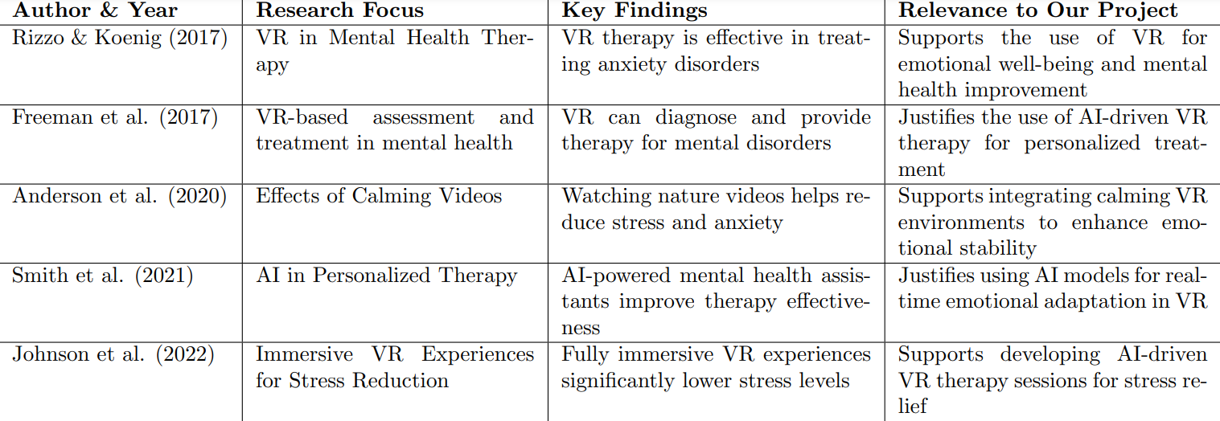
Literature review

Slide 6
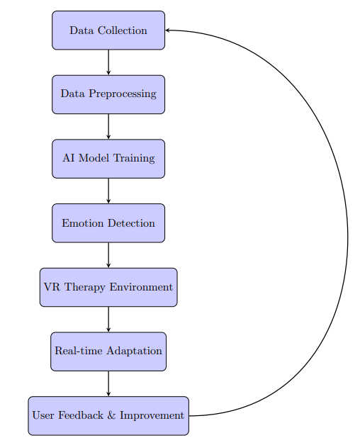
Methodology

Slide 7
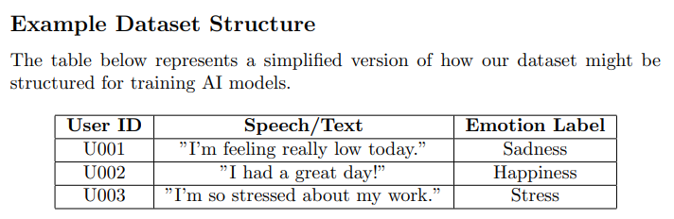
DATASET
To develop our system, we will utilize publicly available datasets related to mental health.

Slide 8
Summary
✅ Objective: Develop an AI-driven VR system for mental health support. ✅ Key Features: Emotion recognition, interactive AI conversations, immersive VR therapy. ✅ Methodology: Deep learning models, NLP for interaction, VR environment integration. ✅ Expected Impact: Personalized therapy, real-time emotional support, scalable mental health solution.

